Slide 1
Session 3: Social Research
Introduction to Sociology
Xuewen @ ASCResearch
March 2022

Slide 2
1
What counts as
sociological research?
Substantive Question
Research types:
Exploratory
Descriptive
Explanatory
Relationship to theory:
Testing existing/competing theories
Building theory from observations
‘a willingness to be bound by certain scientific canons of procedures (Berger 1963:13)
Method
Theory

Slide 3
1
What counts as
sociological research?
1. Systematic methodological procedures
Rule-governed process that restrains the proclivity of the researcher
Transparent to the reader/consumer
Replication

Slide 4
1
What counts as
sociological research?
1. Systematic methodological procedures
Rule-governed process that restrains the proclivity of the researcher
Transparent to the reader/consumer
Replication
2. “value-free” and Verstehen (Max Weber)
Why did this happen? vs How can I persuade people of what I believe in? vs How can I enact a social change?
Verstehen: empathetic understanding of the meanings of people’s social action (i.e., actions oriented towards others).

Slide 5
Social research methods
2
Method | School of thought/Philosophy
Quantitative | Positivism
Qualitative | Interpretivism
Mixed methods | Attempting to integrate the advantages of both approaches

Slide 6
Social research methods
2
Method | Descriptions | Strengths and weaknesses | Common data collection method
Quantitative | Seek to convert information about the social world into numeric form; Use statistics to analyze these data | Strength: Breadth, generalizability; Weakness: Information can be superficial; maybe difficult to reveal people’s meaning systems | Survey/Census Experiments Administrative data Texts and documents (if using quantitative analysis)
Qualitative | Seek to collect information about the social world that cannot readily be converted into numeric form Pays attention to the social world from the subjects’ point of view Resorts to story-telling and scholars’ interpretation in analyzing the data | Strength: Provides in-depth information about individuals’ behavior and meaning-making; sheds light on social process for theorizing Weakness: Often limited to relatively small groups or settings; Not easily generalizable | Qualitative interviews Ethnography Historical and comparative analysis Texts, archives, sound and video analysis (when not using quantitative coding)
Mixed methods | Uses both quantitative and qualitative methods within the same study | Combine the benefits of both methods Could be superficial on both sides | Use fieldwork to develop hypothesis and test them for the general population with quantitative methods First collecting survey data to delineate the general trends, then use interviews to understand the social processes

Slide 7
Research method choice depends on the research question & the scholars’ own training/taste
Examples of quantitative studies:
Rates of intergenerational mobility (Pattern)
Relationship between economic growth and fertility decline (Trends)
The influence of socioeconomic status on health outcomes (Measurable effect)
Examples of qualitative studies:
The decision-process of panelists on proposal funding (e.g., Lamont 2009)
People’s ideas and experience about romantic love (e.g., Illouz 2014; Swidler 2001; Streib 2015)
What caused the start of capitalism? (Marx, Weber)
Notes:
and how those could be related to their class background, as well as cultural and historical contexts

Slide 8
What research method should I use?
I’m interested in understanding how a cult operates and what its members believe in.
I want to know something about the gender pay gap in China.
I want to help the government evaluate whether their job training program has been useful for reducing unemployment.
Notes:
Depends on the research question

Slide 9
Logic of social inference
“The main task of the social sciences is to explain social phenomena.” (Elster, 2007 p9)
Gary King et al. (1994) sees social inference as a fundamental task for both qualitative and quantitative social research(, although not all qualitative researchers might agree).
Inference: deduce more information about the social world from the limited observations we have
Causal inference
E.g., Does having a partner with dementia lead to more stress for the care giver?
Descriptive inference
E.g., trends of divorce in my survey data => generalizable to national trends?
Survey vs census

Slide 10
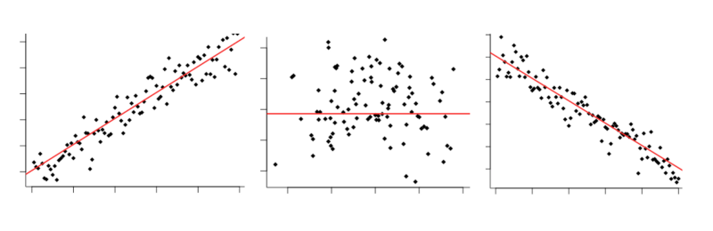
Correlation
Correlation: Two events/behaviors/characteristics vary together

Slide 11
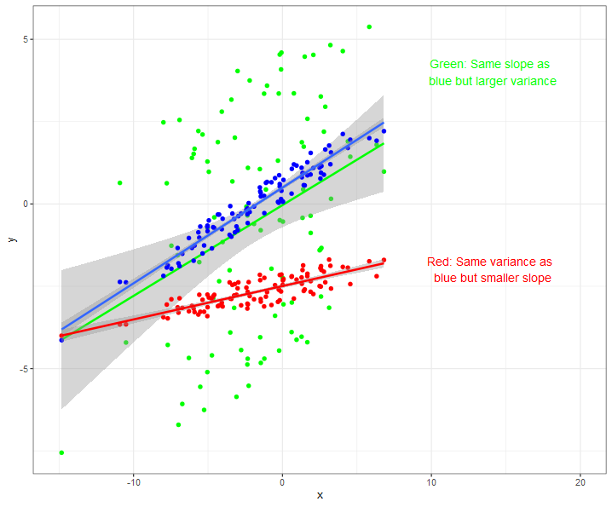

Slide 12
Correlation vs causation
Correlation: Two events/behaviors/characteristics vary together
Causation: One event brings about another event
For quantitative research: causal inference = statistical “correlation” (non-spurious relationship) + a causal story/theory.
Relationship, association, correlation: similar meaning

Slide 13

Correlation vs causation
Families with more books at home also have children with better academic achievement.
Having more books at home leads to an improvement in children’s academic achievement.

Slide 14
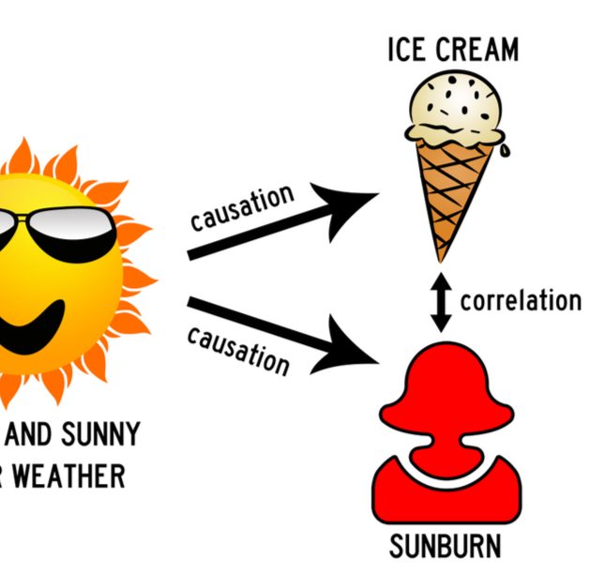
Criteria for causal claim
Statistical correlation
Temporal sequence of the events
There is no third event/factor that explains away the association/correlation

Slide 15
Circumstances where correlation isn’t causation (endogeneity内生性)*
Reverse causation (Dependent variable causing independent var)
E.g., Children with better achievements love reading books more and ask their parents to buy more for them!
Common cause (“confounder” variable; can also be seen as “spurious relationship”)
E.g., Higher family income leads to both more books at home and kids’ academic achievement
Self selection (Those studied/“treated” are systematically different from those that aren’t)
E.g., Parents who participated in our study are themselves more likely to care about kids’ academic achievements;
A typical problem in program evaluation

